Slide 1
Variable Scope and Recursion
By: Timothy Jakubiec

Slide 2
Variable Scope
Variable scope refers to the level of accessibility of the variable.
(This will come up again with access keywords in objects, but for now don’t worry about it).
Each function gets access to a brand new set of local variables .
Local variables consist of two parts.
1. You can have 10 different variables all named t, as long as you have 10 different functions.
2. You lose access to each and every t variable once you reach a function’s return statement.
Global variables that is variables that you have access to across all functions are very very frowned upon in Java, because if you have an incorrect value in that variable, it’s incredibly difficult to find where that value was changed incorrectly.

Slide 3
Runtime Stack (RTS) and Activation Records

Slide 4
A stack
First off, any stack in programming is defined as a “LIFO”, last in first out data structure.
“Popping” something off the stack means to take the item most recently placed on the stack off.
“Pushing” something on the stack means to put a new item on the top of the stack.
Ex: push(1); push(3); push(4); push(5); pop
Pictured on side → what the stack would look like after the
Above function calls were made.
Top
4
3
1
Bottom

Slide 5
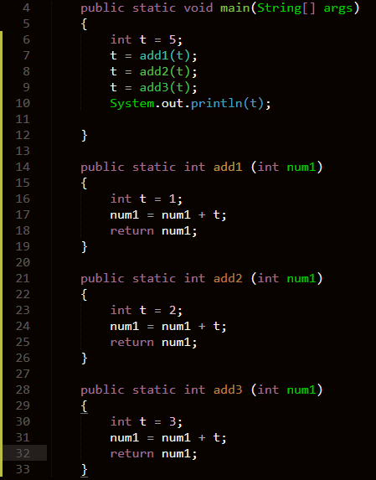
RTS (Runtime Stack)
The RTS is a stack that java uses to keep track of you function calls and what local variables exist at each level.
This code works as expected and prints 11.

Slide 6
RTS and activation records
Each time a function is called, the RTS has an activation record pushed onto it.
Activation records keep track of functions called (keeping track of where to return to) and the local variables in each function call.
Activation records are popped after a function’s return statement is reached, or the closing curly brace is reached.
Ex: Pictured is what the RTS looks like in the previous code up until calling add1 with t as an argument.
Top
main() t → 5
Bottom

Slide 7
RTS add1(t)
Top
t → 1 num1 → 6 add1(5)
add1(5); t → 5 main()
Bottom

Slide 8
RTS add1(5) [after return]
Top
t → 6 main()
Bottom

Slide 9
RTS add2(6)
Top
t → 2 num1 → 8 add2(6)
add2(t) t → 6 main()
Bottom

Slide 10
RTS add2(6) after return
Top
t → 8 main()
Bottom

Slide 11
RTS add3(8)
Top
t → 3 num → 11 add3(8)
add3(t) t → 8 main()
Bottom

Slide 12
RTS add3(8) after return
Top
System.out.println(t) t → 11 main()
Bottom

Slide 13
Recursion

Slide 14
What was all that stack stuff about?
So you don’t write this next topic off as total magic “wizardry” and actually understand how it works.
Recursion is the act of a function calling itself.
Recursion should follow 3 simple rules
1. A base case, a case that is generally trivial and the point at which the function does not have to call itself.
2. A recursive case, a case where the problem is to big and the function has to be called again.
3. Each recursive call should make the problem smaller, (even reducing the problem size by 1 is reducing the problem size)

Slide 15
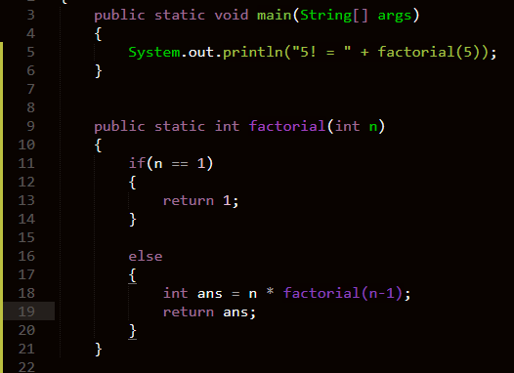
The factorial example

Slide 16
RTS for factorial (Before 1 returns) [Simplified]
Top
return 1;
ans = 2 * factorial(1) factorial(2)
ans = 3 * factorial(2) factorial(3)
ans = 4 * factorial(3) factorial(4)
ans = 5 * factorial(4) factorial(5)
factorial(5) main()
Bottom

Slide 17
Explaining returns
As activation records are popped off the stack, return values get filled into the value of the function calls.

Slide 18
Factorial RTS [return 1]
Top
ans = 2 factorial(2)
ans = 3 * factorial(2) factorial(3)
ans = 4 * factorial(3) factorial(4)
ans = 5 * factorial(4) factorial(5)
factorial(5) main()
Bottom

Slide 19
Factorial RTS [return 2]
Top
ans = 6 factorial(3)
ans = 4 * factorial(3) factorial(4)
ans = 5 * factorial (4) factorial(5)
factorial(5) main()
Bottom

Slide 20
Factorial RTS [return 6]
Top
ans = 24 factorial(4)
ans = 5 * factorial(4) factorial(5)
fact(5) main()
Bottom

Slide 21
Factorial RTS [return 24]
Top
ans = 120 factorial(5)
factorial(5) main()
Bottom

Slide 22
Factorial RTS [return 120]
Top
System.out.println(factorial(5)); “prints” → 120 main()
Bottom

Slide 23
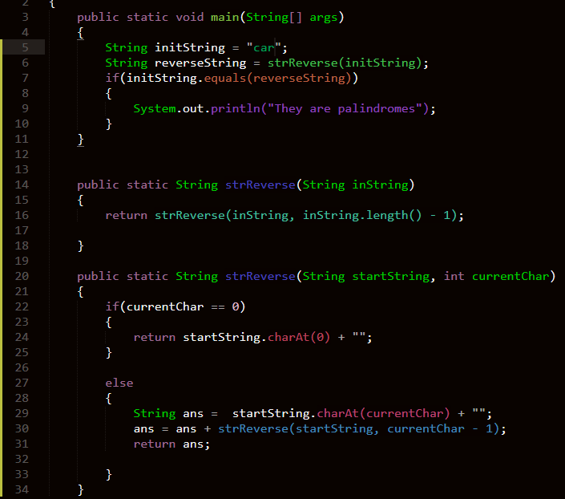
Palindrome Example

Slide 24
Palindrome Example
If you understood that, you’re well on your way to understanding recursion

Slide 25
Next time
Objects!
The kind that Java has already built in:
Strings
Arrays
(Things that allow for user input)

